Slide 1

BRIGHT TV TREND ANALYSIS
2026 Q1 Report
This report Displays the viewership trends analysis of the first quarter of this year
which is Jan- Mar
The analysis will be showcasing mainly:
The most viewed channels
Hourly Viewership
Time viewership segments
Amount of Subscribers by Province
Subscribers by Gender and Race
It will be concluded with recommendations

Slide 2
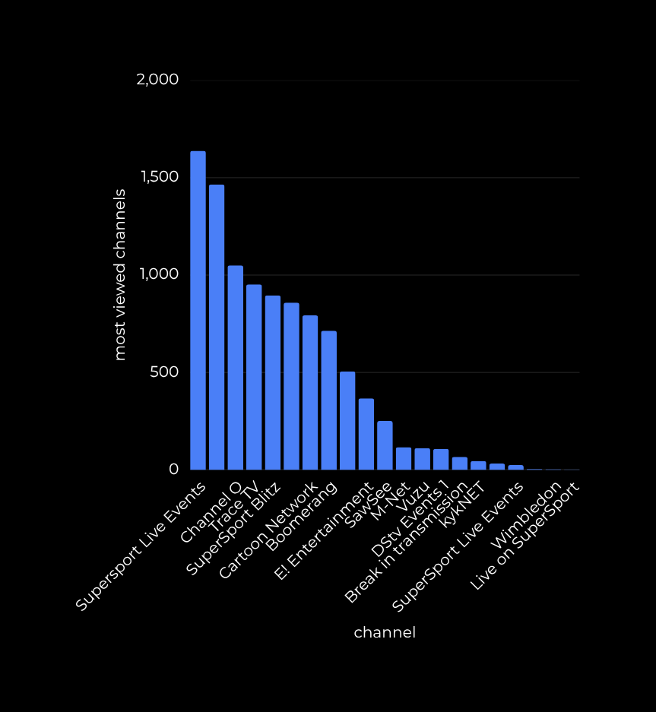
MOST VIEWED CHANNELS
Supersport Live Events came out on top of the most viewed content. this shows that a large number of South African appreciate Live Sporting Events.
Second in place is Channel O, which is a music channel. This shows that a large South Africans appreciate music.
Supersports Blitz came out third, Supersports Blitz showcases highlights of sporting events, which shows many South Africans value their time and prefer to watch summarized matches and games

Slide 3


HOURLY VIEWERSHIP
The time of the day which has the most viewers is 3pm which consists of 38.8% of viewers and the time which has the least viewership is 2am which is 11.6% of viewers

Slide 4


SUBSCRIBERS BY PROVINCE
In terms of provincial subscribers, Guatains contains the most amount of subscribers nationally which is 1704 over the past 3 months which is almost double the amout of subscribers in the Western Cape

Slide 5
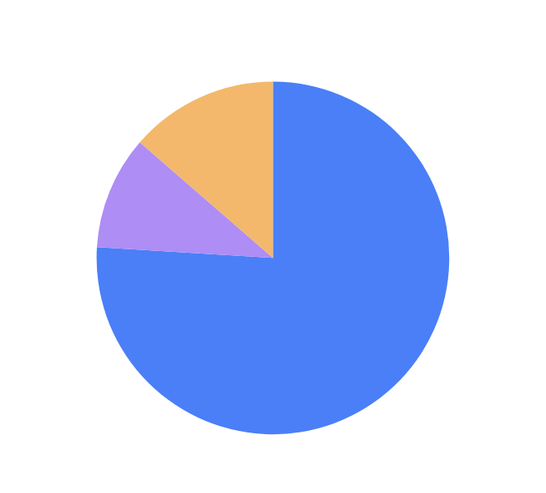

SUBSCRIBERS BY GENDER AND RACE
BrighTV consits of 76% of Males who are overall subscribers , follwowed by females which consits of 10.4% of Bright TV Subscribers. The unspecified demographics are those who do not officially identify as either gender
The Black races makes up 35.2&% of BrightTV subscribers, which ,makes them the majority of subscribers, what is alarmig is the 21% of subscribers which make up the second highest percentage of subscribers do not specify as any race. Inidians are just devided by 0.1%

Slide 6
RECOMMENDATIONS
One of the biggest take-aways from the trend analysis is that females suscribers are 3 times less than those their male counter-parts, so it would be wise to introduce content which caters to females, such as Real Housewives and Love Island and Romantic Comedy Movies/Series
TV shows which have the least amout of views should be allocated to timeslots with the least amout of viewers present
For provinces with the least amount of viewers such as Free State, Northern Cape and the North West, it would be a good idea to have roadshows in the major towns of those arears which consists of sporting events, seeing that a large amount of subscribers view sport and music the most

